Slide 1
Part 1 Diffusion Introduction
Part 2 3D Generation
Lion
BrepGen
GaussianCube
RichDreamer

Slide 2
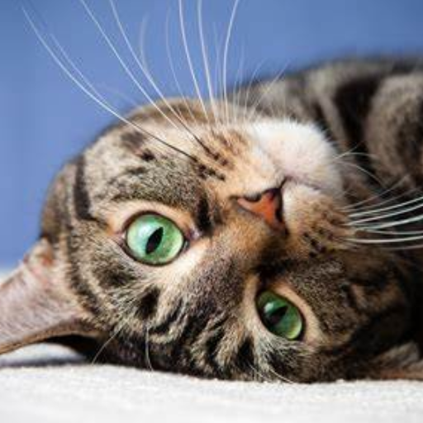
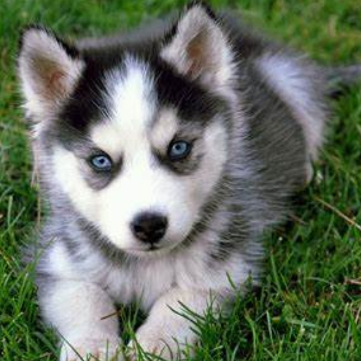
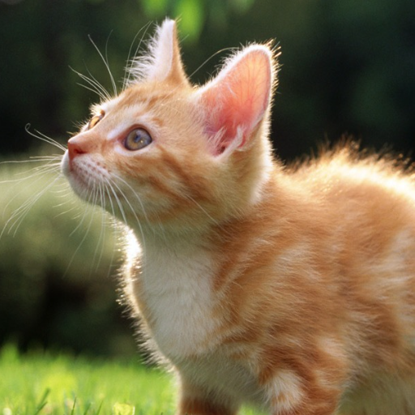
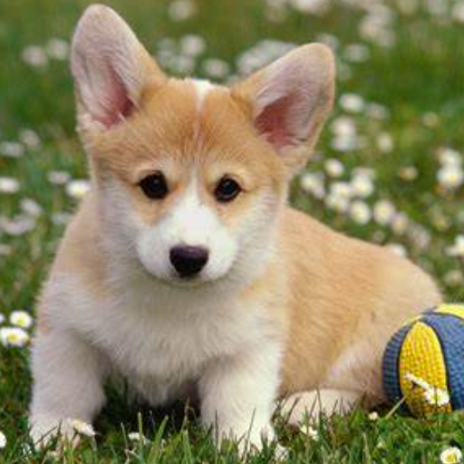
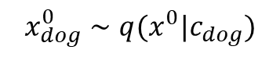
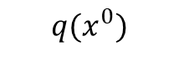
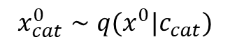
Diffusion Introduction
Data Space
$$x_{cat}^{0}∼q(x^{0}|c_{cat})$$
Data Space
$$x_{dog}^{0}∼q(x^{0}|c_{dog})$$
$$q(x^{0})$$

Slide 3
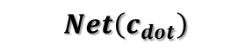
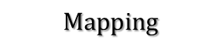
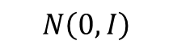
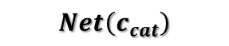
Diffusion Introduction
Data Space and Noise Space
Data Space
Noise Space
$$Net\left(c_{dot}\right)$$
$$Mapping$$
$$Net\left(c_{cat}\right)$$
$$q(x^{0})$$
$$N\left(0,I\right)$$

Slide 4

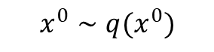
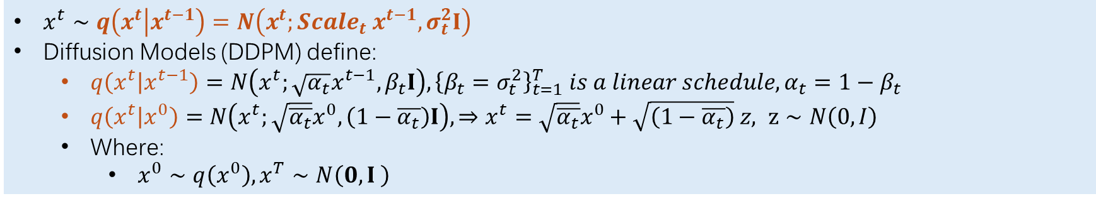
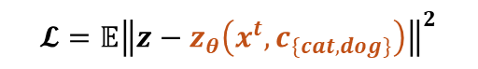
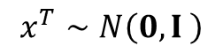
Diffusion Introduction
Forward Conditional Distribution
$x^{t}∼q\left(x^{t} | x^{t−1}\right)=N\left(x^{t};Scale_{t} x^{t−1},σ_{t}^{2}I\right)$
Diffusion Models (DDPM) define:
$q\left(x^{t} | x^{t−1}\right)=N\left(x^{t};\sqrt{α_{t}}x^{t−1},β_{t}I\right), {\left\{β_{t}=σ_{t}^{2}\right\}}_{t=1}^{T} is a linear schedule, α_{t}=1−β_{t}$
$q\left(x^{t} | x^{0}\right)=N\left(x^{t};\sqrt{\overline{α_{t}}}x^{0},\left(1−\overline{α_{t}}\right)I\right),⇒x^{t}=\sqrt{\overline{α_{t}}}x^{0}+\sqrt{\left(1−\overline{α_{t}}\right)} z, z∼N\left(0,I\right)$
Where:
$x^{0}∼q\left(x^{0}\right),x^{T}∼N\left(0,I \right)$
$$x^{0}∼q(x^{0})$$
Data Space
$$𝓛=𝔼{\left\|z−z_{θ}\left(x^{t},c_{\{cat,dog\}}\right)\right\|}^{2}$$
Noise Space
$$x^{T}∼N\left(0,I \right)$$
Diffusion - Training
Ho, J., Jain, A., & Abbeel, P. (2020). Denoising diffusion probabilistic models. Advances in neural information processing systems, 33, 6840-6851.
Sohl-Dickstein, Jascha, et al. "Deep unsupervised learning using nonequilibrium thermodynamics." International conference on machine learning. PMLR, 2015.

Slide 5
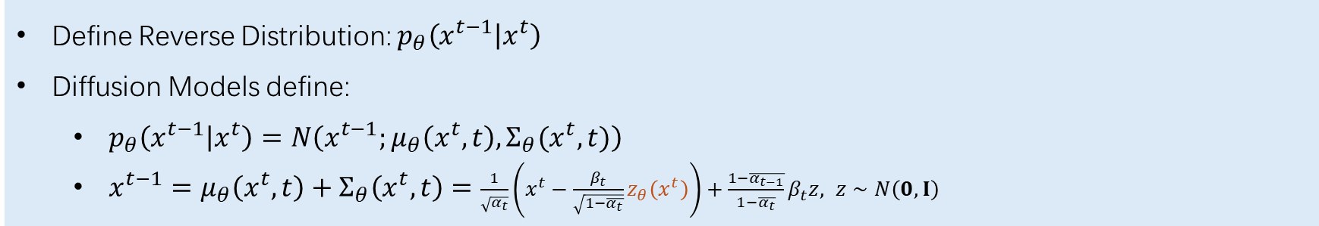
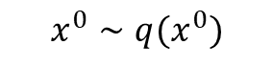
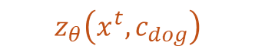
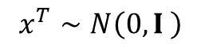
Diffusion Introduction
Reverse Conditional Distribution (for data, i.e. image)
Define Reverse Distribution: $p_{θ}\left(x^{t−1} | x^{t}\right)$
Diffusion Models define:
$p_{θ}\left(x^{t−1} | x^{t}\right)=N\left(x^{t−1};μ_{θ}\left(x^{t},t\right),Σ_{θ}(x^{t},t)\right)$
$x^{t−1}=μ_{θ}\left(x^{t},t\right)+Σ_{θ}\left(x^{t},t\right)=$ $\frac{1}{\sqrt{α_{t}}}\left(x^{t}−\frac{β_{t}}{\sqrt{1−\overline{α_{t}}}}z_{θ}\left(x^{t}\right)\right)+\frac{1−\overline{α_{t−1}}}{1−\overline{α_{t}}}β_{t}z, z∼N\left(0,I\right)$
$$x^{0}∼q(x^{0})$$
Data Space
Noise Space
$$z_{θ}\left(x^{t},c_{dog}\right)$$
$$x^{T}∼N\left(0,I \right)$$
How to reverse this process?

Slide 6
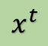
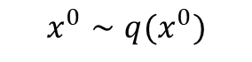
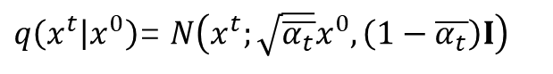
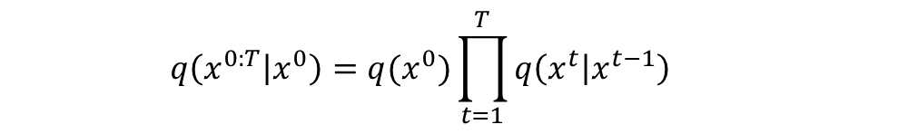
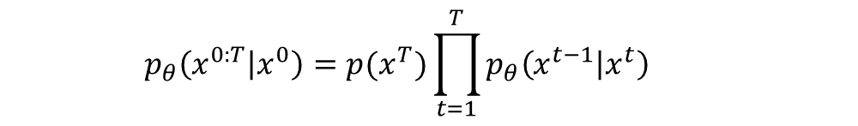
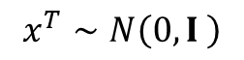
Diffusion Introduction
Form All (joint conditional distribution)
$q\left(x^{t} | x^{0}\right)$= $N\left(x^{t};\sqrt{\overline{α_{t}}}x^{0},\left(1−\overline{α_{t}}\right)I\right)$
$$q\left(x^{0:T} | x^{0}\right)=q(x^{0})\prod_{t=1}^{T}{q\left(x^{t} | x^{t−1}\right)}$$
$$x^{0}∼q(x^{0})$$
Train Network
$$x^{T}∼N\left(0,I \right)$$
$$x^{t}$$
Use Network to Predict
$$p_{θ}\left(x^{0:T} | x^{0}\right)=p(x^{T})\prod_{t=1}^{T}{p_{θ}\left(x^{t−1} | x^{t}\right)}$$

Slide 7
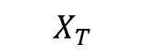
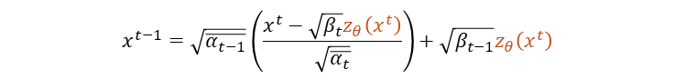
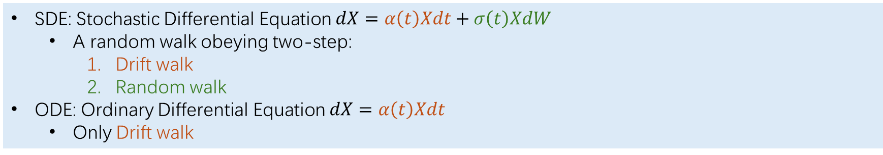
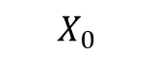
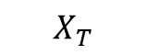
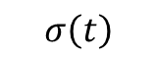
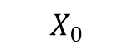
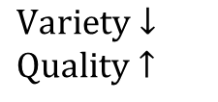
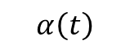
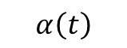
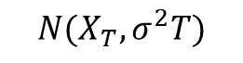
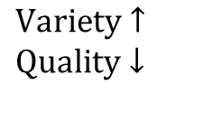
What is SDEs (ODEs) in Diffusion?
SDE and ODE Denoiser
SDE: Stochastic Differential Equation $dX=α\left(t\right)Xdt+σ\left(t\right)XdW$
A random walk obeying two-step:
Drift walk
Random walk
ODE: Ordinary Differential Equation $dX=α\left(t\right)Xdt$
Only Drift walk
SDE Denoiser (e.g. DDPM)
ODE Denoiser (e.g. DDIM)
$$\text{V}\text{ariety}↑$$
$$\text{Q}\text{uality}↓$$
$$\text{V}\text{ariety}↓$$
$$\text{Q}\text{uality}↑$$
$$σ\left(t\right)$$
$$X_{T}$$
$$X_{0}$$
$$α\left(t\right)$$
$$X_{0}$$
$$X_{T}$$
$$α\left(t\right)$$
$$N(X_{T},σ^{2}T)$$
$$x^{t−1}=Scale_{t}^{\left(1\right)}∗x^{t}−Scale_{t}^{\left(2\right)}∗z_{θ}\left(x^{t}\right)+Noise_{t}∗z, z∼N\left(0,I\right)$$
$$x^{t−1}=Scale_{t}^{\left(1\right)}∗x^{t}−Scale_{t}^{\left(2\right)}∗z_{θ}\left(x^{t}\right)$$
$$x^{t−1}=\sqrt{\overline{α_{t−1}}}\left(\frac{x^{t}−\sqrt{β_{t}}z_{θ}\left(x^{t}\right)}{\sqrt{\overline{α_{t}}}}\right)+\sqrt{β_{t−1}}z_{θ}\left(x^{t}\right)$$

Slide 8
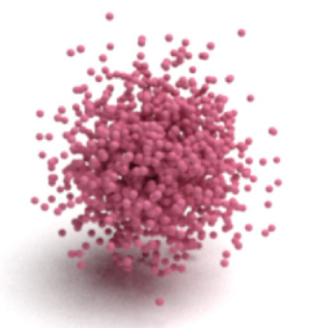
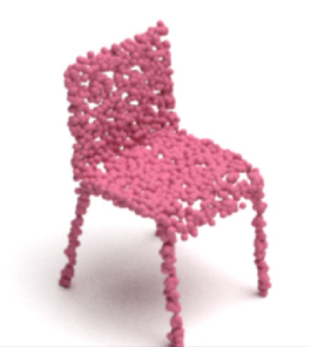
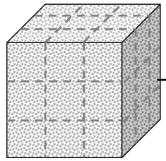
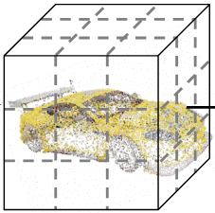
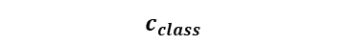
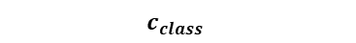
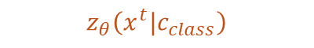
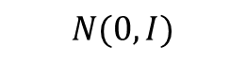
Diffusion
Direct use...
VAE-based...
$$c_{class}$$
Latent Code
$$N(0, I)$$
Latent Code
$$z_{θ}\left(x^{t}|c_{class}\right)$$
$$c_{class}$$

Slide 9
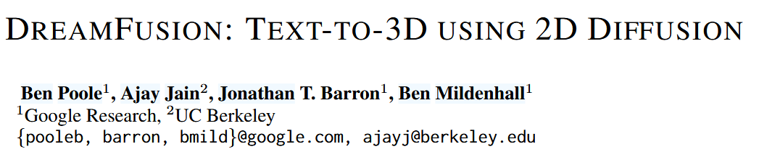
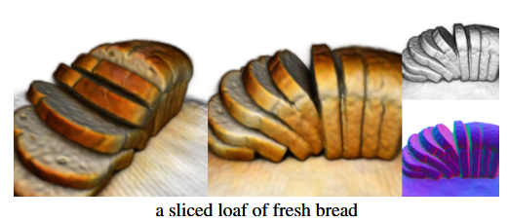

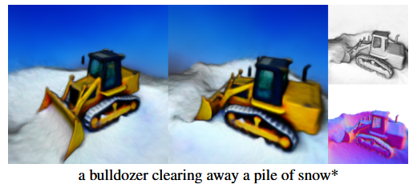

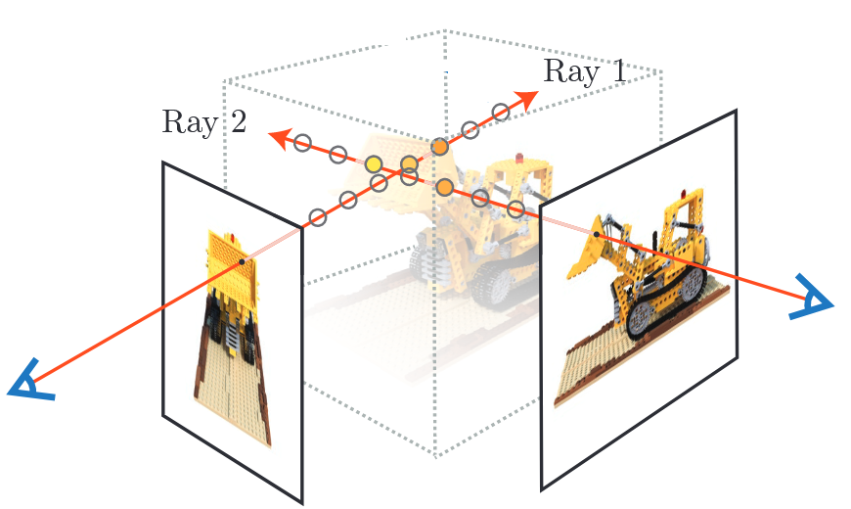
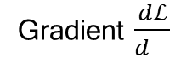

Score Distillation Introduction
Motivation – from 2D to 3D
Text2Image generation is successful.
Text2Shape is hard:
The scarcity of paired 3D-text dataset.
Prompt e.g. Text
Gradient $\frac{dℒ}{d }$
$$+ z∼N(0,I)$$
Key idea is Combining Text2Image and NeRF.
ICLR23: Poole, Ben, et al. "Dreamfusion: Text-to-3d using 2d diffusion." arXiv preprint arXiv:2209.14988 (2022).

Slide 10



Score Distillation Introduction
Overview
$$x=NeRF\left(θ,cam\right)$$

Slide 11



Score Distillation Introduction
About Hugging Face...
Prompt e.g. Text
$$z∼N(0,I)$$

Slide 12





Lion Latent Point Diffusion Models for 3D Shape Generation
Xiaohui Zeng^{123*}, Arash Vahdat¹, Francis Williams¹
Zan Gojcic¹, Or Litany¹, Sanja Fidler¹²³, Karsten Kreis¹
¹NVIDIA ²University of Toronto ³Vector Institute
Decoder
NIPS22: Vahdat, Arash, et al. "Lion: Latent point diffusion models for 3d shape generation." Advances in Neural Information Processing Systems 35 (2022): 10021-10039.
Notes:
A6000

Slide 13



Method
Overview
Decoder
Fuzz Latent Points
Fuzz Shape Latent
PVCNN: Point Voxel CNNs
Point Cloud VAE
SAP: Shape As Points
Input: Point Cloud
Output: Mesh

Slide 14

BrepGen A B-rep Generative Diffusion Model with Structured Latent Geometry
Xiang Xu^{1,2}, Joseph G. Lambourne², Pradeep Kumar Jayaraman²,
Zhengqing Wang¹, Karl D.D. Willis², Yasutaka Furukawa¹
¹Simon Fraser University ²Autodesk Research
SIGGRAPH2024: Xu, Xiang, et al. "BrepGen: A B-rep Generative Diffusion Model with Structured Latent Geometry." arXiv preprint arXiv:2401.15563 (2024).
Notes:
A6000

Slide 15










Structured Latent Geometry
$$N=32$$
$$F_{s}∈R^{N×N×3}→F_{z}∈R^{n×n×3}$$
$$E_{s}∈R^{N×3}→E_{z}∈R^{n×3}$$
$$n=4$$
Surface
Edge
Vertex
E+V
Flatten
Flatten
$$V=\left(x,y,z\right)$$
$$E=[E_{p},E_{zv}∈R^{n×3+6}]$$
$$F=[F_{p}∈R^{6},F_{z}∈R^{n×n×3}]$$
$$E=[E_{p}∈R^{6},E_{z}∈R^{n×3}]$$

Slide 16

Method & Details
“B-reps with more than 30 faces or 20 edges per face, and made from multiple bodies are removed.” (Xu 等, 2024, p. 6)

Slide 17

Method & Details
$Train two VAEs. \left\{F_{s},E_{s}\right\}↔\left\{F_{z},E_{z}\right\}$
$Train four denoiser. 𝒩\left(0,I\right)→\left\{F_{p},F_{z},E_{p},E_{zv}\right\}$

Slide 18




GaussianCube A Structured and Explicit Radiance Representation for 3D Generative Modeling
Bowen Zhang^{1*}, Yiji Cheng^{2*}, Jiaolong Yang^{3†}, Chunyu Wang^{3†}
Feng Zhao¹, Yansong Tang², Dong Chen^{3‡}, Baining Guo³
¹University of Science and Technology of China ²Tsinghua University ³Microsoft Research Asia
Zhang, Bowen, et al. "GaussianCube: Structuring Gaussian Splatting using Optimal Transport for 3D Generative Modeling." arXiv preprint arXiv:2403.19655 (2024).
Notes:
A6000

Slide 19

Method
Overview

Slide 20


Method
Densification-constrained fitting
Replace

Slide 21




Method
Gaussian structurealizaion via Optimal Transport
Gaussians’ spatial positions $\left\{μ_{i},i=1,…,N_{max}\right\}$.
Voxel grid centers $\left\{x_{j},j=1,…,N_{max}\right\}$.
Distance $D_{ij}={\left\|μ_{i}−x_{j}\right\|}^{2}$
After transport:
Note: replace the original Gaussian positions with offsets.
$θ_{k}=\left\{μ_{k}−x_{j},s_{k},q_{k},α_{k},c_{k}\right\}$

Slide 22
Method
Overview

Slide 23



Method
Result & Issues: About Offset

Slide 24
Method
Result & Issues: About Dataset
ShapeNet
OmniObject3D

Slide 25

RichDreamer A Generalizable Normal-Depth Diffusion Model for Detail Richness in Text-to-3D
Lingteng Qiu^{13* †}, Guanying Chen^{2,1*}, Xiaodong Gu³
Qi Zuo³, Mutian Xu¹, Yushuang Wu²¹³, Weihao Yuan³, Zilong Dong³
Liefeng Bo³, Xiaoguang Han^{12 ‡}
¹SSE, CUHKSZ ²FNii, CUHKSZ ³Alibaba Group
Qiu, Lingteng, et al. "Richdreamer: A generalizable normal-depth diffusion model for detail richness in text-to-3d." Proceedings of the IEEE/CVF Conference on Computer Vision and Pattern Recognition. 2024.
Notes:
A6000

Slide 26

Introduction
Overview

Slide 27






Method
Result & Issues
A breathtaking city floating in the sky, with cascading waterfalls, hovering gardens, and buildings connected by bridges of light, 8K, blender 3d.l
a dog pinned down by a huge laptop
Majestic Peacock Throne, golden opulence, feathers adorned with jewels, royal symbolism, 3D asset

